Slide 1

WELCOME
Mobile And Application Development

Slide 2

What are Threads in Android
Mobile And Application Development
Practical
Instructor: Muhammad Naeem Khan

Slide 3
Android Google Map
Android provides facility to integrate Google map in our application. Google map displays your current location, navigate location direction, search location etc. We can also customize Google map according to our requirement.
Types of Google Maps
There are four different types of Google maps, as well as an optional to no map at all. Each of them gives different view on map. These maps are as follow:
Normal: This type of map displays typical road map, natural features like river and some features build by humans.
Hybrid: This type of map displays satellite photograph data with typical road maps. It also displays road and feature labels.
Satellite: Satellite type displays satellite photograph data, but doesn't display road and feature labels.
Terrain: This type displays photographic data. This includes colors, contour lines and labels and perspective shading.
None: This type displays an empty grid with no tiles loaded.

Slide 4
Android Google Map
Syntax of different types of map googleMap.setMapType(GoogleMap.MAP_TYPE_NORMAL);
googleMap.setMapType(GoogleMap.MAP_TYPE_HYBRID);
googleMap.setMapType(GoogleMap.MAP_TYPE_SATELLITE);
googleMap.setMapType(GoogleMap.MAP_TYPE_TERRAIN);

Slide 5
Methods of Google map
Google map API provides several methods that help to customize Google map. These methods are as following:
Methods | Description
addCircle(CircleOptions options) | This method add circle to map.
addPolygon(PolygonOptions options) | This method add polygon to map.
addTileOverlay(TileOverlayOptions options) | This method add tile overlay to the map.
animateCamera(CameraUpdate update) | This method moves the map according to the update with an animation.
clear() | This method removes everything from the map.
getMyLocation() | This method returns the currently displayed user location.

Slide 6
Methods of Google map
Google map API provides several methods that help to customize Google map. These methods are as following:
Methods | Description
moveCamera(CameraUpdate update) | This method reposition the camera according to the instructions defined in the update.
setTrafficEnabled(boolean enabled) | This method set the traffic layer on or off.
snapshot(GoogleMap.SnapshotReadyCallback callback) | This method takes a snapshot of the map.
stopAnimation() | This method stops the camera animation if there is any progress.

Slide 7
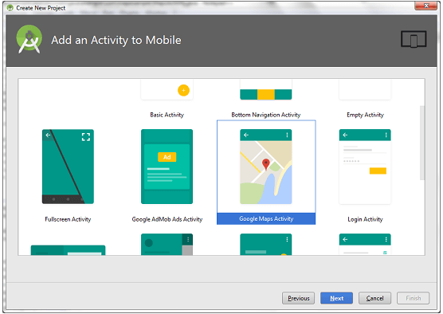
Example of Google map
Example of Google Map
Let's create an example of Google map integrating within our app. For doing this we select Google Maps Activity.

Slide 8
Example of Google map
activity_maps.xml
<fragment xmlns:android="http://schemas.android.com/apk/res/android"
xmlns:map="http://schemas.android.com/apk/res-auto"
xmlns:tools="http://schemas.android.com/tools"
android:id="@+id/map"
android:name="com.google.android.gms.maps.SupportMapFragment"
android:layout_width="match_parent"
android:layout_height="match_parent"
tools:context="example.com.mapexample.MapsActivity" />

Slide 9
Example of Google map
activity_maps.xml
<fragmMapsActivity.java
To get the GoogleMap object in our MapsActivity.java class we need to implement the OnMapReadyCallback interface and override the onMapReady() callback method.
package example.com.mapexample;
import android.support.v4.app.FragmentActivity;
import android.os.Bundle;
import com.google.android.gms.maps.CameraUpdateFactory;
import com.google.android.gms.maps.GoogleMap;
import com.google.android.gms.maps.OnMapReadyCallback;
import com.google.android.gms.maps.SupportMapFragment;
import com.google.android.gms.maps.model.LatLng;
import com.google.android.gms.maps.model.MarkerOptions;
public class MapsActivity extends FragmentActivity implements OnMapReadyCallback{
private GoogleMap mMap;
@Override
protected void onCreate(Bundle savedInstanceState) {

Slide 10
Example of Google map
super.onCreate(savedInstanceState);
setContentView(R.layout.activity_maps);
// Obtain the SupportMapFragment and get notified when the map is ready to be used.
SupportMapFragment mapFragment = (SupportMapFragment) getSupportFragmentManager()
.findFragmentById(R.id.map);
mapFragment.getMapAsync(this); }
@Override
public void onMapReady(GoogleMap googleMap) {
mMap = googleMap; // Add a marker in Sydney and move the camera
LatLng sydney = new LatLng(-34, 151);
mMap.addMarker(new MarkerOptions().position(sydney).title("Marker in Sydney"));
mMap.moveCamera(CameraUpdateFactory.newLatLng(sydney)); } }

Slide 11
Required Permissions
Required Permission
Add the following user-permission in AndroidManifest.xml file.
<uses-permission android:name="android.permission.ACCESS_FINE_LOCATION" />
<uses-permission android:name="android.permission.ACCESS_COARSE_LOCATION" />
<uses-permission android:name="android.permission.INTERNET" />

Slide 12
AndroidManifest.xml
<?xml version="1.0" encoding="utf-8"?>
<manifest xmlns:android="http://schemas.android.com/apk/res/android"
package="example.com.mapexample">
<!--
The ACCESS_COARSE/FINE_LOCATION permissions are not required to use
Google Maps Android API v2, but you must specify either coarse or fine
location permissions for the 'MyLocation' functionality.
-->
<uses-permission android:name="android.permission.ACCESS_FINE_LOCATION" />
<uses-permission android:name="android.permission.ACCESS_COARSE_LOCATION" />
<uses-permission android:name="android.permission.INTERNET" />
<application
android:allowBackup="true"
android:icon="@mipmap/ic_launcher"
android:label="@string/app_name"
android:roundIcon="@mipmap/ic_launcher_round"
android:supportsRtl="true"
android:theme="@style/AppTheme">

Slide 13
AndroidManifest.xml
<meta-data
android:name="com.google.android.geo.API_KEY"
android:value="@string/google_maps_key" />
<activity
android:name=".MapsActivity"
android:label="@string/title_activity_maps">
<intent-filter>
<action android:name="android.intent.action.MAIN" />
<category android:name="android.intent.category.LAUNCHER" />
</intent-filter>
</activity>
</application>
</manifest>

Slide 14
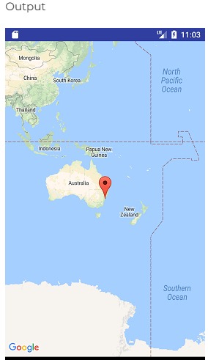
build.gradel
Add the following dependencies in build.gradel file.
dependencies {
implementation fileTree(dir: 'libs', include: ['*.jar'])
implementation 'com.android.support:appcompat-v7:26.1.0'
implementation 'com.google.android.gms:play-services-maps:11.8.0'
testImplementation 'junit:junit:4.12'
androidTestImplementation 'com.android.support.test:runner:1.0.1'
androidTestImplementation 'com.android.support.test.espresso:espresso-core:3.0.1'
}

Slide 15
Threads
In Android, a thread is a unit of execution that can run independently of the main UI thread. Threads can be used to perform long-running tasks without blocking the UI, but they are still part of the same process, not separate background processes.
Threads in Android are typically used to offload tasks from the main thread to avoid freezing the UI. However, they are part of the same application process and share the same memory space. In Java and Kotlin, the Thread class and coroutines can be used to create and manage threads.
Thread thread = new Thread(new Runnable() {
@Override public void run() {
// code to run in background thread
}
});
thread.start();

Slide 16
Threads
There are different types of threads in Android, each with its own use cases:
The main thread, also known as the UI thread, is responsible for handling all UI updates and user interactions. Any code that updates the UI or interacts with the user should be run on the main thread.
Worker threads are used for background tasks that should not block the main thread, such as network requests, database operations, and image processing.
AsyncTask is a helper class that allows you to perform background tasks and update the UI from the same thread. However, it has some limitations and it’s recommended to use coroutines or other libraries for more complex tasks.
Services are used for tasks that should continue running even when the app is not visible, such as playing music or downloading files.
In addition to the above, there are other types of threading mechanisms available in android such as IntentService, JobIntentService, Service, JobScheduler, and AlarmManager.

Slide 17
Threads
It’s important to choose the right threading mechanism for your task to ensure optimal performance and avoid threading issues. It’s also important to test your app thoroughly on different devices and configurations to ensure that it behaves correctly and does not crash due to threading issues.
Step-by-Step Implementation
Step 1: Create a New Project in Android Studio
To create a new project in Android Studio please refer to How to Create/Start a New Project in Android Studio.
The code for that has been given in Java Programming Language for Android.

Slide 18
XML Code
Step 2: Working with the XML Files
Next, go to the activity_main.xml file, which represents the UI of the project. Below is the code for the activity_main.xml file. Comments are added inside the code to understand the code in more detail.

Slide 19
Code In Xml
XML Code
<?xml version="1.0" encoding="utf-8"?> <LinearLayout xmlns:android="http://schemas.android.com/apk/res/android" android:layout_width="match_parent" android:layout_height="match_parent" android:gravity="center" android:orientation="vertical"> <!-- Display the result text --> | <TextView android:id="@+id/result_text_view" android:layout_width="wrap_content" android:layout_height="wrap_content" android:text="Result will appear here" android:textSize="25sp" /> <!-- Start button --> <Button android:id="@+id/start_button" android:layout_width="wrap_content" android:layout_height="wrap_content" android:text="Start" /> </LinearLayout>

Slide 20
Code In Java
Java Code
import android.os.AsyncTask; import android.os.Bundle; import android.widget.Button; import android.widget.TextView; import androidx.appcompat.app.AppCompatActivity; public class MainActivity extends AppCompatActivity { private TextView resultTextView; @Override protected void onCreate(Bundle savedInstanceState) { super.onCreate(savedInstanceState); setContentView(R.layout.activity_main); // Get reference to start button and result text view Button startButton = findViewById(R.id.start_button); resultTextView = findViewById(R.id.result_text_view); // Set an OnClickListener for the start button startButton.setOnClickListener(view -> new BackgroundTask().execute()); } | // BackgroundTask inner class to perform the background task private class BackgroundTask extends AsyncTask<Void, Void, String> { @Override protected String doInBackground(Void... voids) { // Perform background task try { Thread.sleep(5000); } catch (InterruptedException e) { e.printStackTrace(); } return "Task Completed"; } @Override protected void onPostExecute(String result) { // Update UI with the results resultTextView.setText(result); } } }

Slide 21
Thank You

